Slide 1
HOLY FAMILY COMMUNITY SCHOOL
SENIOR CYCLE INFORMATION
26th November, 2021

Slide 2
SENIOR CYCLE COURSES
We hope you find this presentation helpful.
We encourage students to talk to relevant staff members, career guidance teachers and parents/guardians, before making a decision regarding Senior Cycle.
If you have any questions after the presentation, please email the school at info@hfcs.ie and we will do our best to assist you.

Slide 3

Senior Cycle Courses
Leaving Certificate (LC)
Leaving Certificate Applied (LCA)
Transition Year (TY) (optional)

Slide 4
Senior Cycle Application Process
Current Third Year and TY students are guaranteed a place on a Senior Cycle programme, but they must apply for the Senior Cycle course of their choice
Application deadline is Friday, 10th December, 2021
Allocation of places for TY and LCA may be limited. In the event of oversubscription, a lottery will take place
Allocation of Fifth Year subject options will be made after students have ranked their preferences via a Microsoft Form which will be sent to the student’s Microsoft 365 account

Slide 5

Additional Information for Third Year Students
Mock Examinations are scheduled to take place from the 7th – 18th February, 2022.

Slide 6
Leaving Certificate
Students usually take seven subjects for Leaving Certificate, unless they have an official exemption in a subject
Typically, students take the following subjects:
English, Irish, Maths,
French OR German OR Art (if they chose art instead of a language at JC)
Three other subjects from the following list:

Slide 7
Subjects Taken for Leaving Certificate
Biology | Economics | Home Economics | Politics and Society
Chemistry | Construction Studies | Art | Computer Science
Physics | Engineering | Music | Leaving Certificate Physical Education
Business | Design & Communication Graphics | History
Accounting | Technology | Geography

Slide 8
Practical, Project, Oral & Exam Information
English – 100% Written Exam
Maths – 100% Written Exam (25 points for H6 or higher at Higher Level)
Irish – 40% Oral
Accounting – 100% Written Exam
Business – 100% Written Exam
Economics – 100% Written Exam
Geography – 20% Field Study
History – 20% Project
Music – 50% Practical
Art – 50% Project, 37.5% Art History & balance Life Drawing
French – 25% Oral (HL) 20% Oral (OL)
German – 25% Oral (HL) 20% Oral (OL)
Biology – 100% Written Exam
Chemistry – 100% Written Exam
Physics – 100% Written Exam
Home Economics – 20% Project
DCG – 40% Project
Engineering – 50% Project (HL) 60% Project (OL)
Construction Studies – 50% Project (HL) 60% Project (OL)
Technology – 50% Project
PE – 20% Project, 30% Performance Assessment
Computer Science – 30% Project
Politics & Society – 20% Project

Slide 9
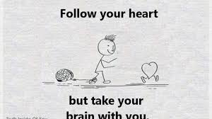
Choosing Subjects
Choosing 5th year subjects requires Research, Reflection and Decision
Students need to consider the following: Interests, Careers, Relevance and Ability
Choose subjects you have enjoyed to date and that you do well in
Never pick a subject just because your friends are doing that subject

Slide 10
CAO Points – Maximise your points
% | Grade | Higher | Ordinary | Points
90-100 | H1 | 100 | O1 | 56
80-90 | H2 | 88 | O2 | 46
70-80 | H3 | 77 | O3 | 37
60-70 | H4 | 66 | O4 | 28
50-60 | H5 | 56 | O5 | 20
40-50 | H6 | 46 | O6 | 12
30-40 | H7 | 37 | O7 | 0
20-30 | H8 | 0 | O8 | 0

Slide 11


Websites and Essential Information
CareersPortal.ie
Qualifax.ie

Slide 12
COURSE REQUIREMENTS
Be aware of requirements for specific courses.
Example: A modern foreign language is a requirement for some university courses
Example: A H4 in Irish is a requirement to study Primary School Teaching
Example: A H5 in Chemistry is required to study veterinary medicine in UCD
DO YOUR RESEARCH
TALK TO OUR CAREER GUIDANCE COUNSELLORS

Slide 13
APPLICATION PROCESS
Application Form for Senior Cycle will be sent via Microsoft Form to the student’s school email
The application will also contain subject option preference for LC
Once a place has been allocated to a particular Senior Cycle programme, it can only be changed if there is room in another Senior Cycle programme
Once LC subjects have been allocated, a subject change will require written parental consent and can only be changed if there is room in the subject required
Application Deadline is 3.40pm, Friday 10th December, 2021

Slide 14
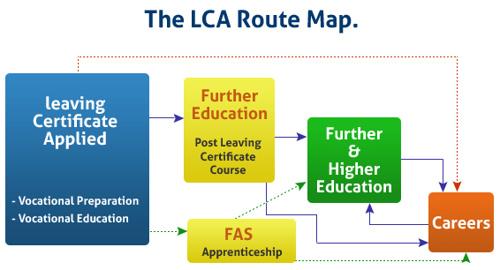
Leaving Certificate Applied
This is a distinct self-contained two-year Leaving Certificate Programme aimed at preparing students for adult and working life.

Slide 15

Who Should Do LCA?
Leaving Certificate Applied is designed for students who –
Find the academic demands of Junior Cycle challenging
Have difficulty completing homework tasks on a regular basis
Prefer practical/activity-based subjects
Do not intend to go directly to university

Slide 16
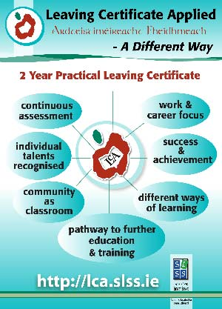

Slide 17

LCA COURSE STRUCTURE
Two-year programme
Divided into four half-year blocks called Sessions
State exams at the end of 5th and 6th Year LCA
Key Assignments and Tasks are completed during each session and these contribute to the final grade/certification
Interviews are an important part of the programme
Certification is based on continuous assessment marked over two years
90% attendance is an essential part of this programme

Slide 18
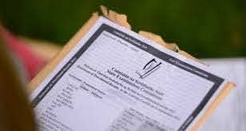
LCA Certification
Certificate Awarded at THREE levels –
Pass – 120-139 credits 60-69%
Merit – 140-169 credits 70-84%
Distinction 170-200 credits 85-100%
LCA Students receive their Leaving Certificate Applied Certification in August each year, on the same day as the traditional Leaving Certificate

Slide 19

LCA WORK EXPERIENCE
One day per week
LCA1 every Monday
LCA2 every Friday
Students are responsible for finding their own work experience placements
Students should book placements early as there can be a demand
A variety of work placements are recommended

Slide 20
TRANSITION YEAR
A one-year school-based programme between Junior Cycle and Senior Cycle
Designed to act as a bridge between the two by facilitating the smooth transition from the more dependant learning of the Junior Cycle to the more independent self-directed learning required for Senior Cycle

Slide 21
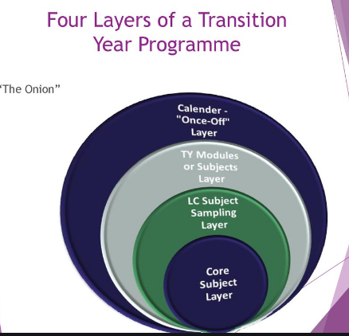

Slide 22
Once-Off Layer
Work experience placements
Visiting speakers
Outdoor pursuits
Excursions
Field trips
Community care – Localise Youth
Volunteering Programme
Focus Ireland Sleep out
Pieta House – Darkness Into Light
Gaeltacht
Tenderfoot/Gaisce/Bridge to College/Walk in my Shoes

Slide 23




TY Modules / Subjects Layer
Science Communications
Law Education (online)
Restorative Practice
SPHE
Guidance
Development Education
First Aid
Drama
Coding (ICT)
GAA Future Leaders
LIFT Programme
Microsoft Office Specialist

Slide 24



LC Subject Sampling
Technology
Design & Communication Graphics
Art
World of Business
Music
History
Politics
Geography
Biology
Chemistry
Physics
Home Economics

Slide 25
Core Subject Layer
All students study –
Mathematics
English
Irish
Modern Language (French/German)
Religion
PE
SPHE
Guidance

Slide 26
TY ASSESSMENT & CREDIT SYSTEM
TY ASSESSMENT
TY CREDIT SYSTEM
Portfolio Assessment
Oral/aural assessment
Project work
Self-assessment
Peer-assessment
Written/practical class tests
Skills assessment
In total there are 500 credits to be awarded
Credits | Percentage | Grade Awarded
375-500 | 75-100% | Distinction
250-374 | 50-74% | Merit
150-249 | 30-49% | Pass
0-149 | <30% | Fail

Slide 27

TY WORK EXPERIENCE
Two weeks in February (preceding the mid-term break)
Students are responsible for finding their own work placement
Book placements early as there is a high demand
A variety of placements is recommended
Garda vetting required if working with children or vulnerable adults

Slide 28
TY COST
TY Fee is €300-€350
Cost of international trips are extra (ranges from €500-€600)
Some ad-hoc trips may incur an additional small cost
Home economics ingredients
HFCS commits to being flexible and transparent regarding costs. We will strive to achieve a balance between a richly rewarding programme and value for money.

Slide 29
Activities/Projects/Outings
Retreat – Avon Ri
TY EXPO RDS
Local Community Involvement – Localise
Go Quest
Gaisce
Bowling
Shoe Box Appeal
Barista Course
Science Week demonstration for HFCS National School
Dublin Zoo
Gaeltacht
Focus Ireland Sleep-Out
Darkness Into Light
Forensics
School of Life
STG Development Education Day with our Primary Schools
Amber Flag

Slide 30
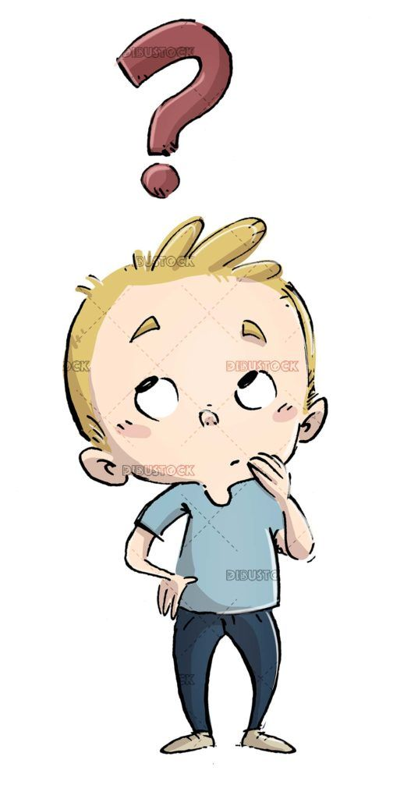
Who Should Do TY?
Someone who is still undecided about their future and wants time to decide
Someone who wants a chance to build up their CV
Someone who wants to become more confident, mature & independent
Someone who is young in the year group
Someone who is willing to get involved in group activities and project work
Someone who wants to gain additional skills

Slide 31

Thank you for watching/reading/listening to this presentation
We hope that we have provided you with some information to help you make the correct decision regarding Senior Cycle
Year Heads will be visiting Third and TY classes over the coming days to support students
We encourage students to talk to the Career Guidance Dept., their teachers and their parents/guardians to get advice
Please email info@hfcs.ie if you have any further questions

