Slide 1
Holy Family Community School
3rd Year Information Night
2020

Slide 2
A message from Mr Shannon
I would like to begin by thanking all of the Third Year parents and guardians for your cooperation during these challenging times. We will continue to keep you updated on any issues as they arise. I would urge you to remind all students about the importance of wearing their masks, adhering to social distancing where possible and following the one way system in school.
It is also very important that all Third years remain focused on their studies and work consistently throughout this year. I look forward to working with you during the year and I wish you and your families all the best.

Slide 3
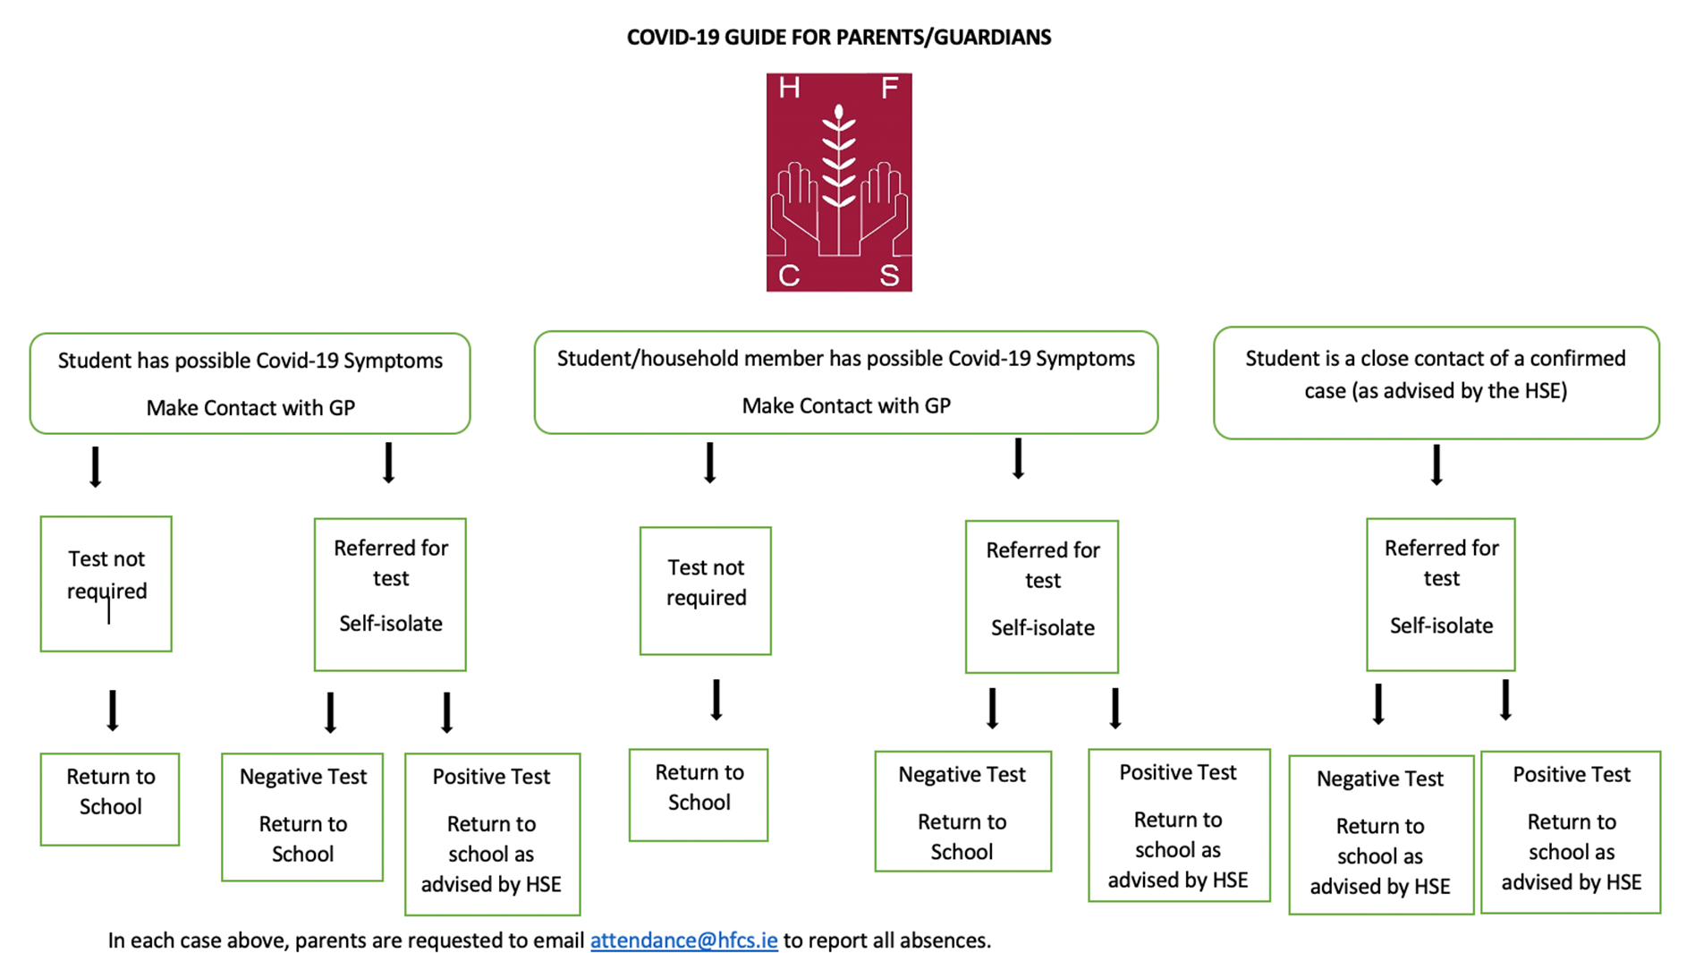

Slide 4

Pastoral Care Team
Teachers & SNAs
Secretaries and Caretakers
Tutors: Hazels: Ms Kane & Ms Quinlan
Lir: Ms Molloy and Mr Purcell
Tara: Ms Doyle and Ms Deasy
Fianna: Ms Callinan and Ms McAndrews
Cuchulann: Ms Keating and Ms Howlin
Cashel Mr Tierney and Mr Hanley: Ms Dollard
Claddagh: Mr Munds and Ms Byrne
Setanta Ms Cowzer and Ms Conneely
Year Head Mr. Shannon
Chaplain Mr. N. McConnell
Guidance Counsellors Ms. K. O’Connell & Ms. C. O’Malley
SEN Coordinator Ms. Paula Dunne
Deputy Principals Mr. D. Maher, Ms. L.Ferguson & Ms. D. O’Keeffe
Principal Ms. B. Kelly

Slide 5

Student Support Team
Team: Principal, Chaplain, Guidance Counsellors, SEN Coordinator
Core Purpose: to coordinate the support available for all students in the school
Referrals from staff, parents and students
Early Bird Enterprise

Slide 6
Junior Certificate Exams
Junior Certificate Levels
  Irish, Maths
  Higher, Ordinary & Foundation Levels
  English (New Junior Cycle Specification)
  Higher & Ordinary Level
  Business, Science, Irish, French, German, Geography, History & Art
  Common Level
  Other subjects not yet in new Junior Cycle
  Higher & Ordinary Level
  CSPE – Common Paper
Summer Report, Parent/Teacher Meeting (5th November To be confirmed), Christmas Report, Mock Report, Teacher’s Advice

Slide 7
Subject Levels
Subject Levels are chosen in March for the Examinations in June
Levels chosen for J.C. and J.C. results affect levels for L.C.
J. C. Maths – no bonus points for higher level
L.C. Maths – 25 bonus points for H1 to H6 grade on higher level paper
L.C. Gaeilge – 40% for Oral Exam

Slide 8

Junior Certificate Exams
Attendance is crucial.
Good work ethic from the start of 3rd Year.
Teachers aiming to have subject’s curriculum largely completed by Mock Examinations (February).
Assessment structures considerably changed in recent years.
Junior Certificate assessments started in some subjects already:
  English – Classroom Based Assessment 1 in 2nd Year
  Science – Classroom Based Assessment 1 in 2nd Year
  Business Studies – Classroom Based Assessment 1 in 2nd Year
  Home Economics project – completed in 2nd Year.
  Project work for technical subjects will start at the end of October / early November in 3rd Year.
  These are subject to change due to Covid 19
All project work to be done in school under the direct supervision of the teacher. Work done outside school not allowed in exam.

Slide 9
Junior Certificate Exams
Home Economics
Examination Components | Dates / Deadlines | Higher Level % of marks | Ordinary Level % of marks | Additional Information
Project Product | Project product and project folder must be completed over a 12 week period in the latter part of second year | 15% 90 marks | 15% 90marks | Students provide their own materials for the product and folder. Students are required to design and make a craft item under the supervision of the teacher. Any work undertaken at home must be agreed with the supervising teacher prior to the work being undertaken. Students may not receive help from any third party. The project is marked by an external examiner in April of 3rd Year
Project Folder
Practical Examination (Cookery) | Start date for practical exams: Early April | 35% 210 marks | 45% 270 marks | Students provide their own ingredients. Students get their exam Task two weeks prior to the exam. There is paperwork (evidence of Planning and Preparation) which must be completed prior to the exam and presented during exam time. A written evaluation must be completed during the exam time. Students get a mock practical exam on their assignment in the two weeks prior to the exam.
Written Examination | June | 50% 300 marks | 40% 240 marks | The format for papers is similar for higher and ordinary. Food & Culinary Skills, Consumer Studies, Resource Management, Social & Health Studies and Textile (Core) are examined on the papers. Higher level students should demonstrate an in depth understanding of the topic when answering questions on the paper. Ordinary level students are required to fill in simpler worksheet type answers.

Slide 10
Junior Certificate Exams
Technology
Examination Components | Dates / Deadlines | Higher Level % of marks | Ordinary Level % of marks | Additional Information
Project Piece | Finishes beginning of May | 30% | 36% | All work to be done by the student in school under the supervision of the teacher.
Project Folio | Finishes beginning of May | 20% | 24% | The folio may be done at home.
Written Examination | June | 50% | 40%

Slide 11
Junior Certificate Exams
Metalwork
Examination Components | Dates / Deadlines | Higher Level % of marks | Ordinary Level % of marks | Additional Information
Project Piece | Starts circa last week in October Finishes in mid April | 37.5% 150 marks | 75% 300 marks | All practical work must be done in school. No part of the project piece may be done outside school.
Practical Examination | May | 37.5% 150 marks | None | The practical examination pieces must be prepared in school prior to the examination and they must be the students’ own work.
Written Examination | June | 25% 100 marks | 25% 100 marks

Slide 12
Junior Certificate Exams
Materials Technology (Wood)
Examination Components | Dates / Deadlines | Higher Level % of marks | Ordinary Level % of marks | Additional Information
Project Piece | Late April | 40% | 40% | All practical project work must be done under the supervision of the teacher.
Project Folio | Late April | 25% | 25% | The instructions are on page 2 of the brief given to each student in early November. Students must write up the project under 5 headings: Analysis; Research & Investigation; Development of Ideas; A-Z Making; Conclusion & Evaluation. Sketches, photographs, illustrations, colour and presentation are very important.
Written Examination | June | 35% 100 marks | 35% 100 marks | Students must answer 16 out of 20 short questions and 3 out of 5 long questions (including 1 drawing question which is not compulsory). Students must bring their own equipment to the exam: ruler, 2 set squares (60º and 45º), 2H pencils and masking tape.

Slide 13
Visual Art
Components | Dates/Deadlines | Level / % | Additional Information
Phase 1 Classroom Based Assessment 2 Visual Art Sketchpad Communicate & Reflect Form | September – Early December | Common level Descriptor | Brief issued in September. Students research and present work in visual art sketchpad for assessment. Communicate & Reflect. Form filled on completion of CBA2.
Phase 2 State Certified Final Assessment Workbook Artefact 1 Artefact 2 | January – early May | Common level Workbook – 50% Artefact 1 – 25% Artefact 2 – 25% | Workbook issued early January. Students further develop ideas from CBA 2 in workbook and make two artefacts. Completed artefact & workbook assessed in early May.

Slide 14
Junior Certificate Exams
Music
Examination Components | Dates / Deadlines | Higher / Ordinary Level % of marks
Practical Exam (Performance) | March / April | 25%
Written Examination (Listening, Composing & General Study) | June | 75%

Slide 15
Junior Certificate Exams
Science
Examination Components | Dates / Deadlines | Higher / Ordinary Level % of marks | Additional Information
Classroom Based Assessment 1 | During 2nd Year | Descriptor | Assessed in school by teacher. Results for this were included in Summer Exam report, 2018
Science in Society Investigation Classroom Based Assessment 2 | Dec / January (3 weeks) | Descriptor | The student will, over a three week period, research a socio-scientific issue, analyse the information collected, evaluate the claims and draw evidence-based conclusions about the issues involved.
Assessment Task | 28th January | 10% | Based on Learning Outcomes of Classroom Based Assessment 2
Written Examination | June | 90%

Slide 16
Junior Cycle English
Examination Components | Dates / Deadlines | Marks | Additional Information
Classroom Based Assessment 1 Oral Communication | During 2nd Year | Descriptor | Assessed in school by teacher. Results for this were included in Summer Exam report, 2018
Classroom Based Assessment 2 Two Texts from student’s portfolio | 3rd and 4th December | Descriptor | Students choose two pieces of their work for the Assessment Task
Assessment Task | December | 10% | Completed in class and sent to the SEC for marking
Final Assessment | June | 90% | Completed during the State Examinations held in the school

Slide 17
Junior Cycle Business Studies
Examination Components | Dates / Deadlines | Marks | Additional Information
Classroom Based Assessment 2 | December | Descriptor | Assessed in school by teacher
Assessment Task | December (Before Christmas Break) | 10%
Final Assessment | June | 90% | Completed during the State Examinations held in the school

Slide 18
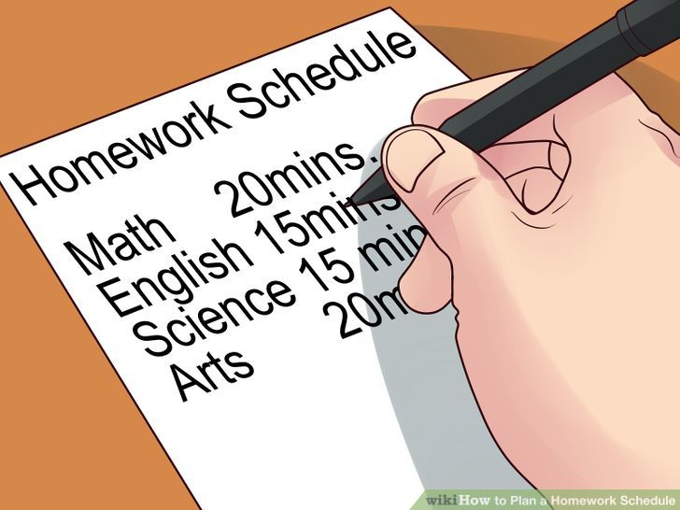
Study
Quiet, well-lit space with a desk and chair
No television, music, phone, computer games...
2-3 hours per night, 6 days per week
Study plan
  Written homework
  Learning homework
  Revision
Basic Equipment – Dialann, books, copies, pens, pencils, ruler, parer, eraser, calculator

Slide 19
Other items
Past Examination Papers
Study and Revision Plans
Student Personal Accident Insurance €10 - 24/7 Cover
Supervised Study Form available from Reception. Return to Ms. Connaughton.( To be confirmed )
Examination fees are due in March.

Slide 20
New Junior Cycle Framework
Junior Cycle Profile of Achievement
Assessment of schoolwork - 3rd Year CBA & Assessment Task
  Exceptional
  Above expectations
  In line with expectations
  Yet to meet expectations
Terminal examination (June)
  Distinction
  Higher Merit
  Merit
  Achieved
  Partially achieved
  Not Graded
Certificate to include a report on Wellbeing and other areas of learning including CSPE Mini Action Project
www.ncca.ie or www.juniorcycle.ie

Slide 21
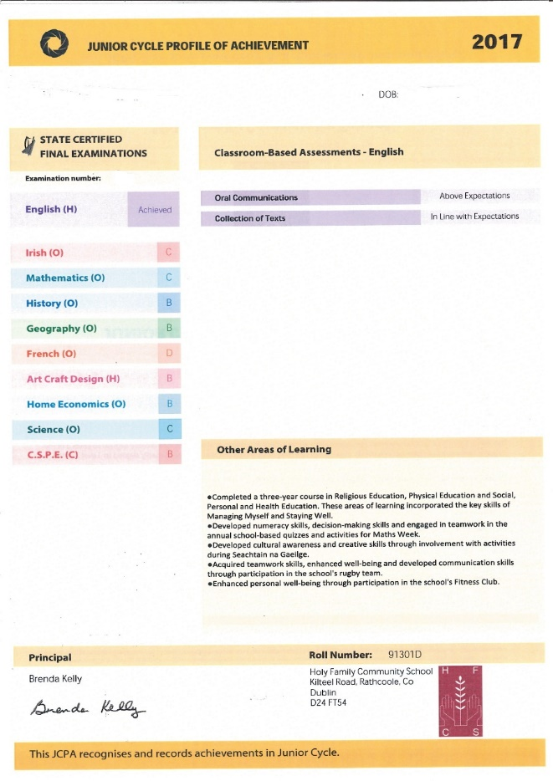
Junior Cycle Profile of Achievement

Slide 22

Senior Cycle Courses
Transition Year (TY)
Leaving Certificate Applied (LCA)
Leaving Certificate (LC) (LCVP optional)

Slide 23
Senior Cycle
Senior Cycle Curriculum provision is planned during 3rd Year:
  Student Assembly during November and an Information Meeting on 18th November at 7.00pm ( To be confirmed ). It’s very important that parents attend this meeting.
  December– students fill in application forms for Senior Cycle Programmes. This will allow students’ details to be updated and will determine demand for Transition Year, Leaving Certificate Applied and Leaving Certificate Programmes.
  December - subject option forms completed by prospective Leaving Certificate students. It is very important that all forms are completed accurately.

Slide 24
School Procedures
Dialann
Punctuality and Attendance
Uniform
Sickness procedures
Car park for staff use only
Bus bays must kept clear
All parents / visitors must report to reception
Parents / visitors are not allowed on in the school building or on the yard unless accompanied by a member of staff
Students are expected to be ‘good neighbours’
Impression given by large student groups
Changed contact details?

Slide 25
Student Conduct
Conduct on and while queueing for Buses
Internet / Cyberbullying
Weapons
Fireworks

Slide 26
Important Dates
Parents’ Association AGM – TBC
Talk re. young people & social media
Parent/Teacher Meeting – TBC
Information Meeting re Senior Cycle Programmes, 5th Year Subject Options and Careers – TBC

