Slide 1
Holy Family Community School
5th Year Information Night

Slide 2
Congratulations!
To all our students who have just completed Third year. It was a very exceptional year. We are looking forward to an enjoyable and productive Fifth year.

Slide 3
School Times - 2020/2021
1 Hour Classes.
Start & finish times:
  School open to students at 8.25am but students must go straight to their timetabled classroom.
  Classes begin at 8.45am
  Classes end at 3.40pm on Monday, Tuesday, Thursday and Friday.
  Classes end at 1.00pm on Wednesday.
Morning break is 15 minutes. Students must stay in their base classroom.

Slide 4
Lunchtime Procedures:
Students may go down to the village but if they remain in school they must:
Remain in base classroom from 1.00-1.20pm
At 1.20pm they go to the Basketball court near phase 4 and middle alcove until the bell goes at 1.40pm.
On wet days, all students must remain in their base classroom for the full duration of the break.

Slide 5


Settling In
Welcome to our new students & parents.
5th Year – is a mix of 3rd Year, T.Y. and new students.
It has been an exceptional transition to senior cycle.
Some students did not expect things to change.
Some students find the changes unsettling at first.
But our Tutor group system will support the students – they engage in a pastoral care class on Wednesday.
There are different groups of students in every subject.
But there are also higher expectations re work and behaviour.

Slide 6

Pastoral Care Team
Teachers & SNAs
Secretaries and Caretakers
Tutors for Fifth year R51 - Mr. O Rourke R52 - Ms. Ní Fhátharta
R53 - Ms. Ryan-Clarke R54 – Ms. Phipps
R55 - Ms. Mc Cabe R56 – Mr. Meredith
Year Head Ms. Finnegan
Chaplain Mr. N. McConnell
Guidance Counsellors Ms. K. O’Connell & Ms. C. O’Malley
SEN Coordinator Ms. Paula Dunne
Deputy Principals Mr. C. Morrin, Ms. I. Fallon, Ms. D. O’Keeffe
                (From October 2020 - Mr. L. Ferguson and
                Mr. D. Maher)
Principal Ms. B. Kelly (From October 2020 - Ms. I. Fallon)

Slide 7

Communication
Please notify us of changes to
Parent/Guardian contact details
Letters and SMS texts are sent home.
Phone calls to/from school (01 4580766 / 01 4580031).
Christmas and Summer school reports.
Parent/Teacher meetings.
Meetings for specific issues – special educational needs, health, family issues, bullying, suspension.
Information meetings.
Website www.hfcs.ie; Twitter https://twitter.com/hfcsrathcoole
Email info@hfcs.ie or attendance@hfcs.ie (for reasons of absence).

Slide 8
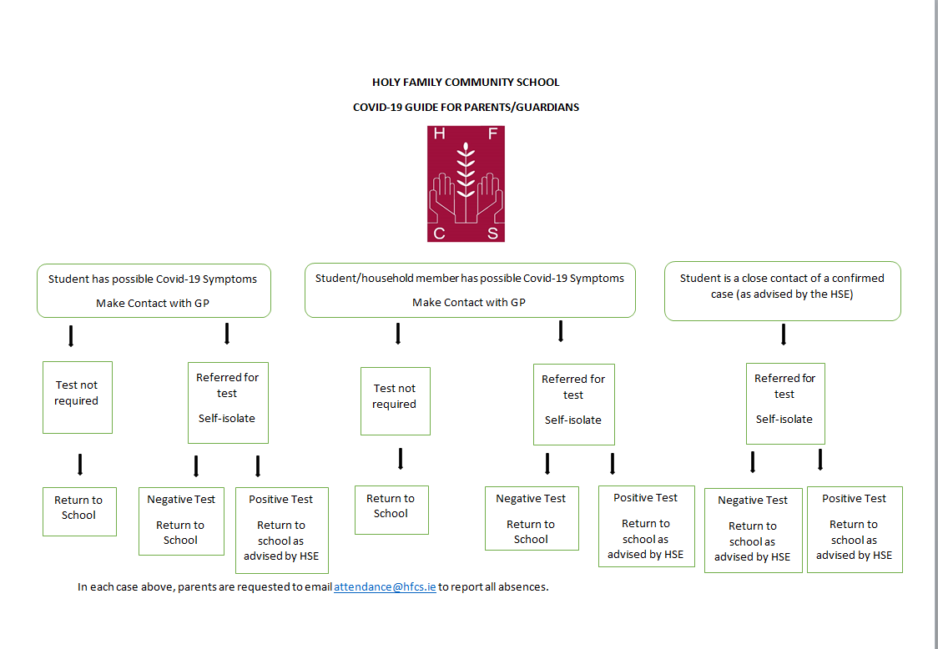

Slide 9

Student Support Team
Team: Principal, Chaplain, Guidance Counsellors, SEN Coordinator
Core Purpose: to coordinate the support available for all students in the school
Referrals from staff, parents/guardians and students.

Slide 10

Leaving Certificate Curriculum
Students take
7 / 8 Exam Subjects
Irish, English, Maths.
French, German, Art.
Three other subjects
P.E. , R.E., SPHE/Guidance

Slide 11

Changing Option Subjects
Considerable number of changes made already. Any further changes need to be made sooner rather than later.
Note from parent/guardian.
There will only be changes if a place is available and if requested early enough – do not wait until 6th Year !

Slide 12
Leaving Certificate - Levels
Maths and Irish: Higher (H) (A)
Ordinary (O) (G)
Foundation (F) (B)
All other subjects: Higher (H) (A)
Ordinary (O) (G)
Students must bring a note from a parent/guardian if they wish to change a level. The note must be presented to their subject teacher and Year Head.

Slide 13
Leaving Certificate
All students are expected to work hard and aim for the highest level possible.
Students’ Leaving Certificate levels will not be higher than their Junior Certificate levels.
  Students find it more difficult and have to work harder to achieve the same grades in their Leaving Certificate examinations as they achieved in their Junior Certificate examinations.

Slide 14
Languages
Irish Oral Exam – 40% - all levels
Irish Written & Aural Exam – 60%
French Oral Exam –25% (H), 20% (O)
French Written & Aural Exam – 75% (H), 80% (O)
German Oral Exam – 25% (H), 20% (O)
German Written & Aural Exam – 75% (H), 80% (O)

Slide 15
Leaving Certificate Programme
Attendance and punctuality are crucial.
Good work ethic from the start of 5th Year.
Teachers aiming to have a substantial amount of the curriculum covered during 5th Year.
Some Leaving Certificate projects will start during 5th Year: Home Economics journal ( 20%).
Project work in technical subjects will start at the end of October / early November in 6th Year.

Slide 16
Leaving Certificate Grades
H1/O1 90-100%
H2/O2 80<90%
H3/O3 70<80%
H4/O4 60<70%
H5/O5 50<60%
H6/O6 40<50%
H7/O7 30<40%
H8/O8 0<30%

Slide 17
Leaving Cert. Grades & CAO Points
Higher Level Ordinary Level
90-100% H1 100 O1 56
80<90% H2 88 O2 46
70<80% H3 77 O3 37
60<70% H4 66 O4 28
50<60% H5 56 O5 20
40<50% H6 46 O6 12
30<40% H7 37 O7 0
0<30% H8 0 O8 0
LCVP Distinction (80 – 100%) 66 CAO points
Merit (65 – 79%) 46 CAO points
Pass (50 – 64%) 28 CAO points
Bonus points for H6 or higher in higher level Maths

Slide 18
Dealing with Issues / Concerns
Existing procedures in place in this school.
Stages:
  Teacher / Tutor / Year Head.
  Deputy Principal.
  Principal.
  Representatives of the Board of Management.
  Full Board of Management.
  Teaching Council.
Complaints Procedure on School’s website.

Slide 19

Parents’ Council
Registered with National Parents Council Post Primary (NPCPP).
Parents’ voice in the school.
Liaise with Senior Management of School.
Engage in development of school policies and procedures.
Support the school e.g. fund-raising, bag packing in December.
All parents are members of the Parents’ Association.
Members of the Parents’ Council are elected at the AGM.
New members needed.

Slide 20
School Calendar /Absences
  No half days/early closing without note home. This is accompanied with a text message in most cases.
  Absences can be emailed to attendance@hfcs.ie or a note in the Dialann to be given to Tutors.
  Medical appointments during school day– note from parent, signed by Year Head, Principal or Deputy Principal. Student must then sign out at reception.
  Sickness procedures – student must not use mobile phone. Student should get the teacher’s permission to go to Reception. School Secretary will phone home. Student must sign out at Reception and leave by the front door when collected by parent.

Slide 21
Dialann
Every student must have a Dialann
  Students are not allowed out of class unless they have their Dialann with them containing a signed note from their teacher.
It is an important organisational tool
Timetable – Ensure that this is written into the Dialann.
Recording of homework is very important.
Calendar – it is important to check this for events.
Code of Behaviour & Discipline – it is very important to read this and understand it.
Policy on the use of student personal electronic devices is very important especially in the current situation.
Notes for absenteeism

Slide 22
Aids to Success
Set Goals
Reflect on Junior Certificate results
Good attendance
Organisation – be prepared
Homework/study plan (place, time…)
No personal electronic devices while studying
Supervised study
Support from family, school and friends

Slide 23
Obstacles to Success
Unrealistic expectations
Poor attendance
Poor study environment
Missing homework /project deadlines
Part-time work
Extra-curricular activities
Social life
Holidays during term time

Slide 24


Extra-curricular activities
Encourage them to get involved, but not in everything
To remember they are representing the school and good behaviour will be expected
To do the assigned homework.
Personal Accident Insurance Scheme - €10

Slide 25
School Procedures / Parking
In these exceptional times, Parents/guardians are not allowed in the school without an appointment or permission from the Principal.
All visitors must report to Reception and be accompanied by a member of staff in the building and on the yard.
Senior Cycle students may park on school property provided they comply with section 7.4 of the Code of Behaviour.

Slide 26
Student safety entering and exiting school:
  Parents are asked not to park in or close to the school gateway (including roundabout).
  The Lower gate is to be used by pedestrians only.
  Top gate to be used by staff only.

Slide 27

Student Conduct
Conduct on Buses
  Continuation of bus service and reputation of school at stake
  Queuing for 8.20am bus in Saggart – poor behaviour becoming an issue. Students are supervised while queueing outside of the school at 3.40pm.
Fire Extinguishers/Break Glass Units/Evacuation Notices and Signs
  Criminal act to damage these.
Weapons & Fireworks
  E.g. pen knives, pellet guns, laser pens, toy/replica guns.
  Students must not carry kitchen knives, craft knives, blades used in Science classes etc.
  Fireworks/Bangers completely banned – hefty suspension for any students involved.
Good Neighbours – manners, litter, road awareness, not allowed to congregate in local housing estates.

Slide 28
Important Dates
Parent/Teacher Meeting – To be confirmed

