Slide 1

Holy Family Community School
6th Year Information 2020/2021

Slide 2

Changes This Year 2020/21
One-way system
CoVid19 protocols (social distancing, face masks, etc)
See the next slide for CoVid19 Guide for Parents/Guardians

Slide 3
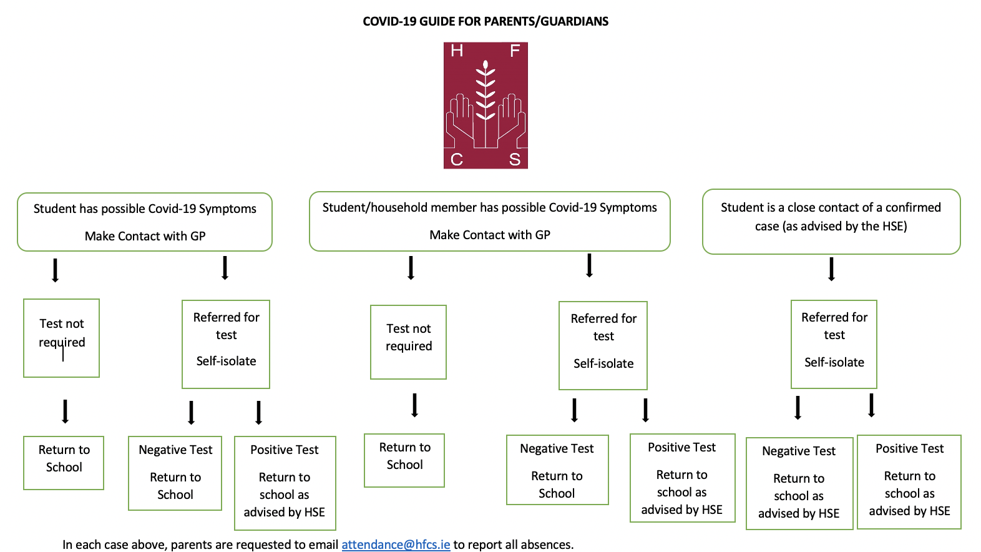

Slide 4
Leaving Certificate Levels
Maths and Irish Higher (H) / Ard (A)
Ordinary (O) / Gnáth (G)
Foundation (F) / Bonn (B)
All other subjects Higher (H) / Ard (A)
Ordinary (O) / Gnáth (G)
Students choose the level on examination day

Slide 5


Tips for success
Attendance and punctuality
Work ethic from the start of 6th Year
Importance of balance
Subject’s curriculum largely completed by Mock Examinations (February)
Leaving Certificate assessments have started already:
  Home Economics journal
Project work will start at the end of October/early November
Project work to be done in school under direct supervision of the teacher.

Slide 6
Languages
Gaeilge Oral Exam – 40%
Gaeilge Written & Aural Exam – 60%
French/ German Oral Exam – 25% (H) 20% (O)
French/ German Written & Aural Exam – 75% (H) 80% (O)

Slide 7

Updated Version to the LC Examinations for June 2021
https://www.education.ie/en/Schools-Colleges/Information/Curriculum-and-Syllabus/assessment-arrangements-junior-cycle-and-leaving-certificate-examinations-2021.pdf

Slide 8
Biology, Chemistry & Physics
There are compulsory experiments in all three subjects
Experiments must be completed and written up under the supervision of the class teacher
Student’s responsibility to catch up on any work missed due to absenteeism
Experiment notebooks must be submitted to a Department of Education inspector if requested

Slide 9
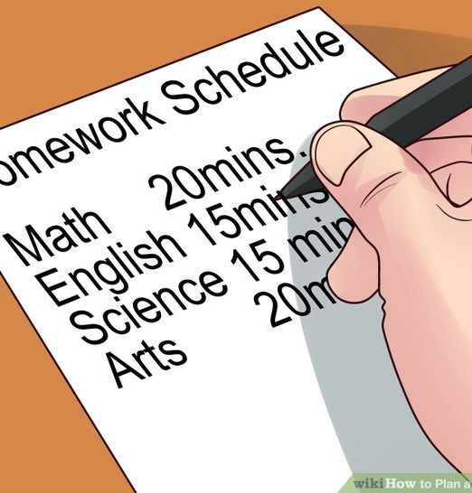
Study
Quiet, well-lit space with a desk and chair
No television, music, phone, computer games...
Minimum 2 hours per night, extra hours at the weekend
Study plan
  Written homework
  Learning homework
  Revision
Supervised study (€60 per term)
Basic Equipment – Dialann, books, copies, pens, pencils, ruler, parer, eraser, calculator

Slide 10
Leaving Certificate Final Year
Oct.–Apr.
Project Work
December
PLC applications online
January
CAO application
February
Mock Examinations
Pay L.C. Exam Fees (€116, paid online)
April & May
Oral and Practical Exams
LCVP Written Exam
June
Written Exams
August
Results
Apply to view Exam Script
Aug.–Sep.
View Exam Scripts/Appeal results
CAO offers / Start courses
October
Return of Projects after the Leaving Certificate

Slide 11
Leaving Cert. Grades & CAO Points
Grade Higher Level Ordinary Level
90-100% H1 100 O1 56
80<90% H2 88 O2 46
70<80% H3 77 O3 37
60<70% H4 66 O4 28
50<60% H5 56 O5 20
40<50% H6 46 O6 12
30<40% H7 37 O7 0
0<30% H8 0 O8 0
LCVP Distinction (80 – 100%) 66 CAO points
Merit (65 – 79%) 46 CAO points
Pass (50 – 64%) 28 CAO points
25 Bonus points for H6 or higher in higher level Maths

Slide 12
Points System
6 subjects used to calculate points
6 Ordinary Level Subjects
6 X 6 O1 = 6 X 56 = 336 points
6 X 6 O6 = 6 X 12 = 72 points
6 Higher Level Subjects
6 X 6 H1 = 6 X 100 = 600 points
6 X 6 H7 = 6 X 37 = 222 points
3 Higher Level & 3 Ordinary Level Subjects
6 X 6 H1/O1 = 3 X 100 + 3 X 56 = 468 points
6 X 6 H7/O6 = 3 X 37 + 3 X 12 = 147 points

Slide 13
Next Year
Courses accessed through the CAO (Central Applications Office)
Courses outside of the state (UCAS)
Post Leaving Certificate (PLC) Courses
Apprenticeships (Solas / FÁS)
Gardai, Army, Teagasc, Failte Ireland
Work
Repeat Leaving Certificate
CAO Information Meeting – Monday, 13th January at 4.00pm

Slide 14
Repeat Leaving Certificate
To be avoided if possible
Department of Education & Skills criteria
Availability of places and subjects
Too old for second level school ?
College specialising in one-year Leaving Certificate more appropriate ?
Is the student likely to achieve better results ?
Fees
Consider other options

Slide 15
References
PLC Courses-references required at short notice
One week’s notice required for written reference from school
Reference Form available at reception
Staff should be informed if they have been used as a referee
UCAS references – 2 weeks minimum notice required

Slide 16
Student File at Home
Birth Certificate
PPSN
Passport
Junior Certificate results
Other Certificates e.g. First Aid, ECDL
Reports – school, work experience
References
Copies of application forms
Leaving Certificate Examination number / pin
CAO booklet, number and password
Common Email (Gmail) accessible by student and parents

Slide 17

Pastoral Care Team
Teachers, SNAs, Secretaries and Caretakers
Tutors Ms. T. O’Brien (Ms. Z. Feighery) Mr. J. Darcy
      Ms. A. O’ Gara
      Ms. U. McDonnell
      Mr. M. Egan
      Mr. C. Gormley
      Ms. C. Perris
  Year Head Mr. D. Maher
  Chaplain Mr. N. McConnell

Slide 18
Pastoral Care Team
Guidance Counsellors Ms. K. O’Connell & Ms. C. Perris
AEN Coordinator Ms. Paula Dunne
Deputy Principals Mr. C. Morrin, Ms. I. Fallon & Ms. D.O’ Keeffe
Principal Ms. B. Kelly
Student Support Team

Slide 19
School Procedures
Correct students’ names needed for examination certificates
SMS text alert re: attendance
If your child is absent: please contact attendance@hfcs.ie with your child’s name, year group and reason for absence.
If you have changed address or phone number, please contact info@hfcs.ie to update.
Parent contact details – changes?
    Voluntary contribution – all help needed
    Student Insurance Scheme - €10 for 24 / 7 cover

Slide 20
Complaints / Concerns
Stages:
  Teacher / Tutor / Year Head
  Principal
  Representatives of the Board of Management
  Full Board of Management
  Teaching Council
Complaints Procedure on School’s website

Slide 21
Dates for Diary
Please keep an eye on the school website for important school dates.
This is an evolving situation due to COVID19.

