Slide 1
Holy Family Community School
2nd Year Information Night

Slide 2

Pastoral Care Team
Teachers & SNAs
Secretaries and Caretakers
Tutors to: Ballagh: Ms. L.Doyle & Mr. E. Mulvihill
  Picasso: Mr. L.O’Sullivan & Mr. M.O’Gallachóir Da Vinci: Mr. B.McLoughlin & Ms. C.Finn
  Le Brocquy: Mr. P.Hassett & Mr. T.Bolger
  Dali: Ms. L.Hogan & Ms. M.Morrin
  Yeats: Mr. S. Murphy & Ms. M.Moynihan
  Gray: Ms. L.Creighton & Ms. S.Daly
  Year Head Ms. S. Connaughton
Chaplain Mr. N. McConnell
Guidance Counsellors Ms. K. O’Connell & Ms. C. O’Malley
AEN Coordinator Ms. Paula Dunne
Deputy Principals Ms. I. Fallon, Mr. C. Morrin & Ms. D.O’Keeffe
From October 2020: Mr. D. Maher and Mr. L. Ferguson.
Principal Ms. B. Kelly
From October 2020: Ms. I. Fallon.

Slide 3

Student Support Team
Team: Principal, Chaplain, Guidance Counsellors, AEN Coordinator
Core Purpose: to coordinate the support available for all students in the school
Referrals from staff, parents and students
Reasons for referrals

Slide 4

Communication & Support
  Parent contact details – please inform the school of any changes to address and phone numbers.
  School Calendar
  SMS Texts
  Reports
  Website and Twitter
  Student Insurance Scheme - €10 for 24 / 7 cover
  Easy Payment System

Slide 5

School Procedures
Punctuality / Attendance / Absence notes
    Medical appointments (if appointment during school hours) – note from parent signed by Year Head, Deputy Principal or Principal
    Sickness procedures – Do not use mobile phone. Student gets teacher’s permission to go to Reception. Sign out at Reception and leave by the front door
    Home pass during lunch time (to go home only)
    No half days / early closing without note home
    Family Holidays
Dialann
Uniform

Slide 6
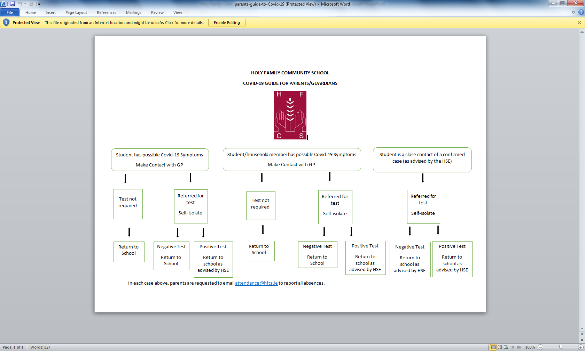

Slide 7
Changes This Year 2020/21
Break and Lunch time arrangements:
2nd year students go to their designated base rooms at morning break (10.45-11.00am) everyday with the exception of Wednesday (10.50-11.05am).
Lunch time arrangements:s
2nd years go to the basketball court near phase 4 and the middle alcove from 1.00-1.20pm. They then return to their base class from 1.20-1.40pm.
On wet days, all students must remain inside for the duration of the lunch break.
Attendance procedures:
If your son/daughter does not attend school due to illness/family reasons etc. please email the school at ‘attendance@hfcs.ie’. In the subject box, please write the year and class group your child is in.

Slide 8
Teaching and Learning
JC does not just happen in June 2022
  3 Year Programme
  New Junior Cycle Classroom Based Assessments (CBA) for English, Irish, French, German, Science, Art, Maths, Home Ec., History, Music Geography & Business Studies in 2nd and 3rd Year
  Skills, e.g. Art, Woodwork, Metalwork, etc.
  Ground work covered for 3rd Year JC Projects
  Attendance absolutely essential
  Students should be aiming for the highest level possible
  Supervised Study – Ms. S. Connaughton

Slide 9
Teaching and Learning
Phased introduction of Junior Cycle
Remaining subjects – old Junior Certificate syllabi
All subject classes are mixed ability classes with the exception of English, Gaeilge and Maths.

Slide 10
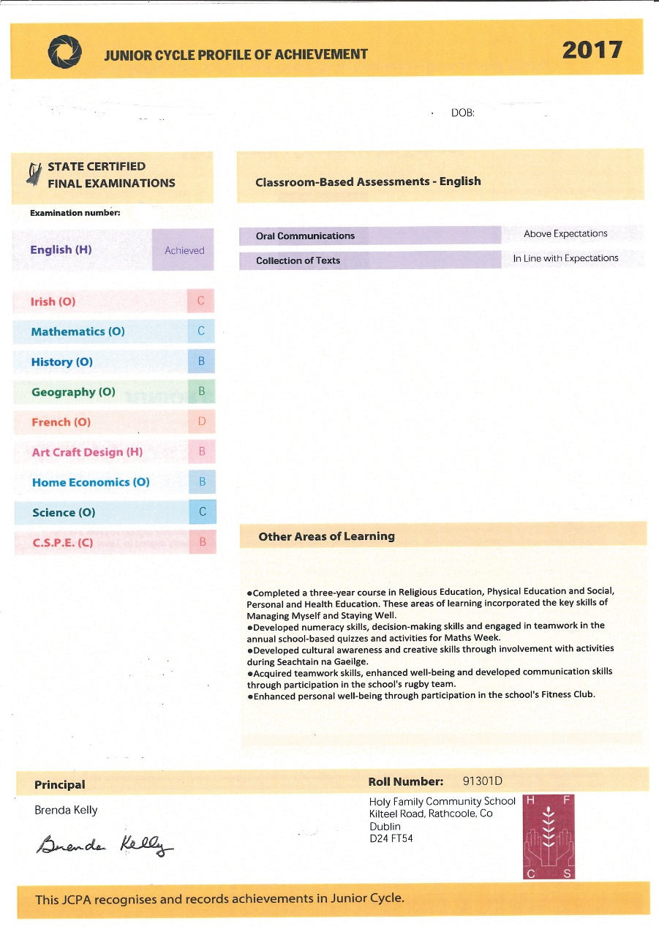
Junior Cycle Profile of Achievement

Slide 11
Classroom Based Assessments
The Classroom Based Assessment Calendar will be available to students and parents on the website in the coming weeks.
On this calendar you will be able to identify the subject and date of each CBA.

Slide 12

Homework
Homework Policy: a minimum of 1.5 hours per night.
Encourage your son/daughter to write their subjects for the upcoming week into their dialanns on a Sunday evening and to record homework next to the relevant subject.
Revision of class work is an essential part of homework.
Written work may also be assigned.
Parents are encouraged to supervise the completion of homework and to sign their son/daughter’s Dialann at the end of each week.

Slide 13
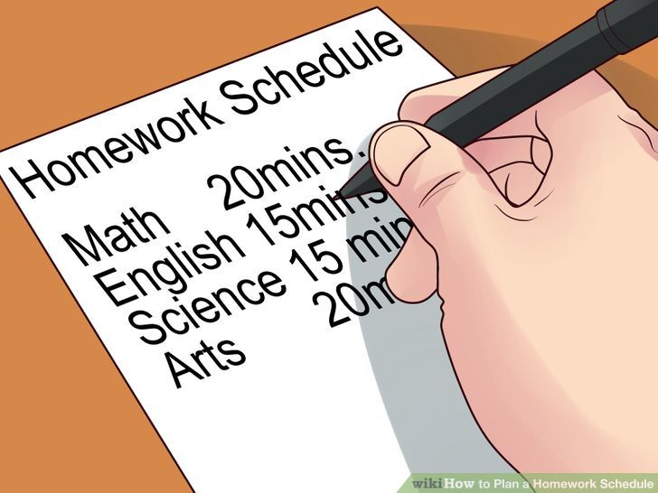

Homework
Desk/designated area
Mobile phone left elsewhere
IT/ Music free zone
Stationary supply: copybooks, pens, pencils
Establish routine
Break homework up into sessions
Allow time for activities in routine
Homework first, relaxation second

Slide 14
Personal Electronic Devices
  This policy is necessary to ensure that:
  There is no disruption to teaching and learning
  Students are not late for class because they are using these devices
  Harassment and bullying do not take place by means of these devices
  Prevent the invasion of the privacy of members of the school community

Slide 15
Personal Electronic Devices Contd…
must be switched off and kept out of sight during school day
must not be used in the toilets or the PE hall at any time
Students may be asked to leave their mobile phones on the teacher’s desk when leaving the classroom during class time.
AUP is available on the school website (currently under construction/upgrade)

Slide 16

Student Conduct
Internet
  Social network sites banned during school time
  Privacy settings should be enabled
  Can be a source of bullying
  Number of “friends” / Limits of “friendship”
  Sexting
Weapons
  Including pen knives, pellet guns, laser pens, toy/replica guns – not allowed
  Fireworks / Bangers completely banned – hefty suspension for any students involved.

Slide 17
Student Conduct Contd…
Conduct on Buses
  Continuation of bus service and reputation of school at stake
  Orderly queue while waiting to board the bus
  No smoking, horseplay, bad language, vandalism
  Be mannerly to other passengers and driver
  Sit in seats and wear seat belts if provided
Fire Extinguishers / Break Glass Units / Evacuation Notices and Signs
  Criminal act to damage these
  Suspension / Expulsion and replacement cost
  Suspension for students not cooperating during a fire drill
  Fireworks / bangers completely banned – hefty suspension for any students involved.

Slide 18

Awards
Merit Cards: all students can succeed
  awarded to student
  signed by parent(s)
  exchanged for lollipop
  end-of-term awards
Attendance Awards: Certificates
Sports Awards: Certificates
Academic Awards: Certificates

Slide 19
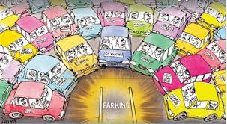
Parking / Drop off & Pick up
For Health and Safety reasons:
Drop off and pick up students at the front of the school
Do not stop on the roundabout or in the school gateway or across the driveways of houses
    Due to Covid-19 and to ensure the health and safety of all, parents and visitors must contact the school directly to make an appointment.
    Parents and visitors are not allowed in the school building or yard unless accompanied by a member of staff

Slide 20

Important Dates
Parent/Teacher Meeting – to be confrmed

Slide 21

Parents’ Council
Parents’ voice in the school
Liaise with Senior Management of School
Engage in development of school policies and procedures
Support the school e.g. fund-raising
All parents are members of the Parents’ Association
Members of the Parents’ Council are elected at the AGM
New members needed

Slide 22
And Finally….
Pursuit of Academic Excellence
Education provides Opportunity

