Slide 1

Holy Family Community School
LCA Information 2020/2021

Slide 2

Changes This Year 2020/21
One-way system
Covid-19 protocols (social distancing, face masks, etc.)

Slide 3
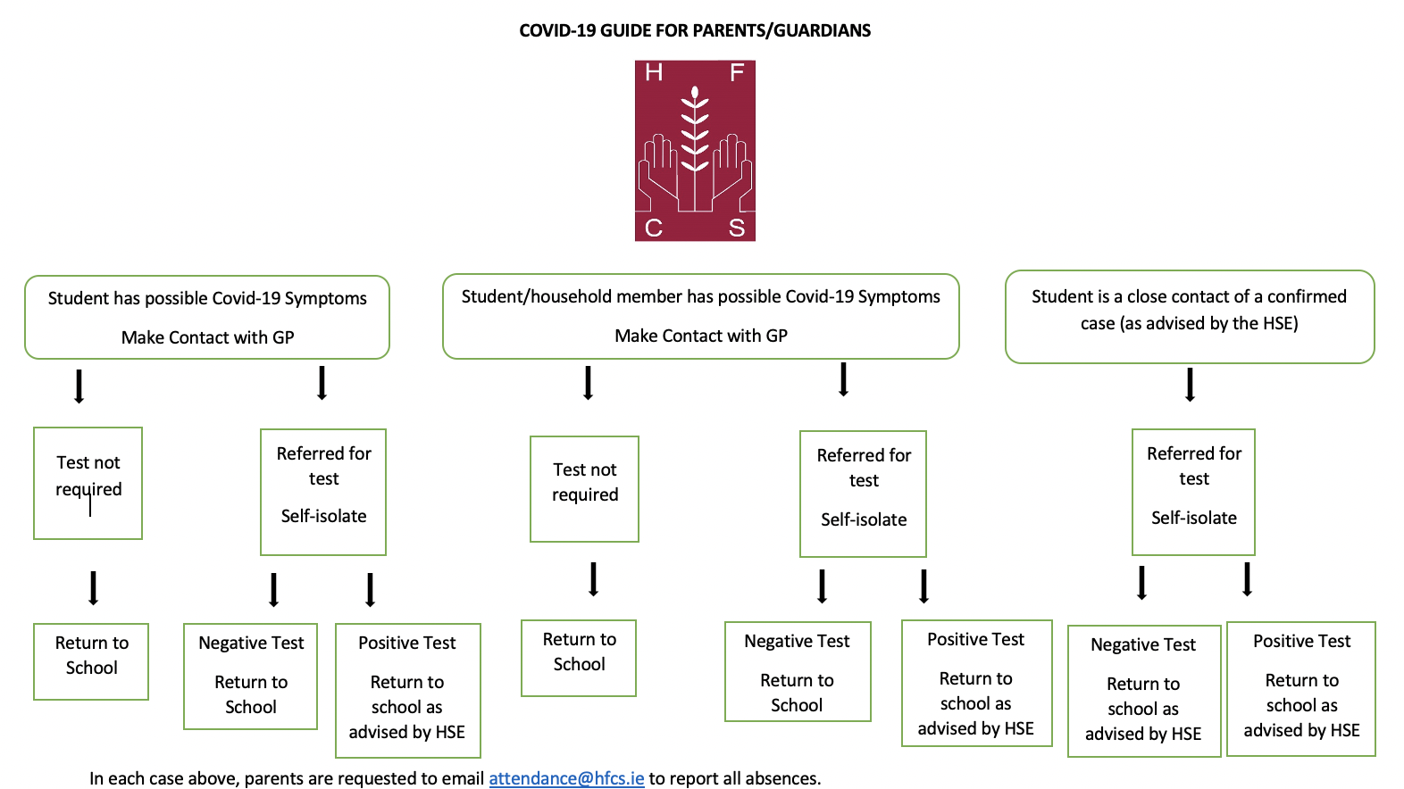

Slide 4


Pastoral Care Team
Teachers, SNAs, Secretaries and Caretakers
LCA1 Tutor Ms. M. Bates
LCA2 Tutor Mr. C. Gormley
  LCA1 Year Head Ms. O. Finnegan
  LCA2 Year Head Mr. D. Maher
  LCA Programme Coordinator Ms. L O'Brien
  Chaplain Mr. N. McConnell

Slide 5
Pastoral Care Team
Guidance Counsellors Ms. K. O’Connell & Ms. C. Perris
AEN Coordinator Ms. Paula Dunne
Deputy Principals Mr. C. Morrin, Ms. I. Fallon & Ms. D. O’ Keeffe
Principal Ms. B. Kelly
Student Support Team

Slide 6
Student File at Home
Birth Certificate
PPSN
Passport
Medical Records (if applicable)
Junior Certificate results
Other Certificates e.g. First Aid, ECDL
Reports – school, work experience
Copies of application forms
Common Email (Gmail) accessible by student and parents

Slide 7
School Procedures
Correct students’ names needed for school records
SMS text alert re: attendance
If your child is absent: please contact attendance@hfcs.ie with your child’s name, year group and reason for absence.
If you have changed address or phone number, please contact info@hfcs.ie to update.
If your child has any medical conditions i.e. peanut allergies etc the school must be informed.
    Voluntary contribution – all help needed
    Student Insurance Scheme - €10 for 24 / 7 cover

Slide 8
Complaints / Concerns
Stages:
  Teacher / Tutor / Year Head
  Principal
  Representatives of the Board of Management
  Full Board of Management
  Teaching Council
Complaints Procedure on School’s website

Slide 9

LCA: LEAVING CERTIFICATE APPLIED
The Leaving Certificate Applied is a two-year programme to prepare students for adult and working life.

Slide 10


Slide 11
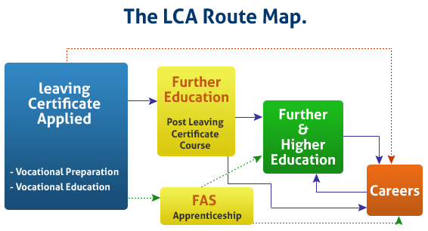

Slide 12

Course Structure
2 Year Programme
Divided into 4 half-year blocks called Sessions
Key assignments must be completed during each session
Based on continuous assessment- marked over the two years
90% attendance is a major part of this course

Slide 13
HFCS' LCA Curriculum
Vocational Preparation | Vocational Preparation & Guidance English & Communications
Vocational Education | Mathematical Applications Vocational Specialisms* (Hotel, Catering and Tourism & ICT) 3. Information Communication Technology
General Education | Arts Education (Visual Arts) Social Education (Social Health) Languages (Gaeilge and French) Leisure & Recreation (including Physical Education)
Elective Courses | Religious Education

Slide 14
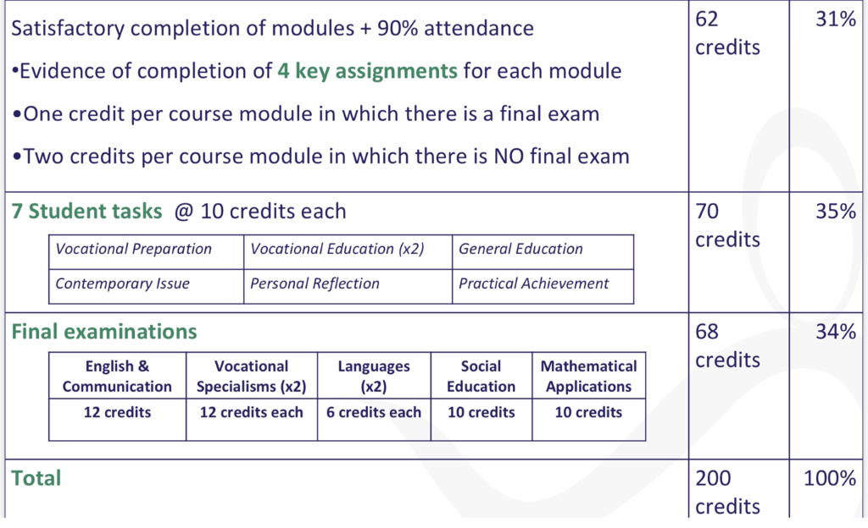
LCA Assessment Breakdown

Slide 15
Student Tasks
There are 7 Student Tasks (projects) to complete over the 2 years
Tasks | Credit | % | Completed in session | Assessed
1.General Education Originating in Arts Education, Leisure & Rec., Language or Social Education | 10 | 5 | 1 | Jan/Year 1
2. Vocational Preparation Originating in either Vocational Preparation & Guidance or English & Communication | 10 | 5 | 2 | May/Year 1
3. Vocational Education - 1st specialism Originating in one Vocational Specialism | 10 | 5 | 2 | May/Year 1
4. Vocational Education - 2nd specialism Originating in the second Vocational Specialism | 10 | 5 | 3 | Jan/Year 2
5. Contemporary Issues Anchored in Social Education | 10 | 5 | 3 | Jan/Year 2
6. Practical Achievement Generally out of school/centre | 10 | 5 | 3 | Jan/Year 2
7. Personal Reflection Statement 1 from year one will be stored and returned to SEC when statement two is complete | 10 | 5 | on-going | May/Year 2

Slide 16

Subjects
Students must complete all of the following subjects in LCA:
English and Communications
Mathematical Applications
Gaeilge (Irish) is covered in 5th year
French is covered in 6th year
Vocational Preparation: Guidance, Jobsearch, Enterprise 1& 2, Work Experience 1, 2&3 , Community Work, Work and Living

Slide 17

Subjects
Hotel Catering and Tourism (Specialism)
Arts- Visual Art
Introduction to Communication and Technology (ICT) in 5th Year
Religious Education (Elective)
Information and Technology (Specialism)
Social Education
Leisure and Recreation

Slide 18
Students can obtain a total of 200 credits over 4 sessions in two years:
Year 1
Session 1:
16 credits for completing modules
10 credits for completing a student task
26 credits in total
Session 2:
19 credits for completing modules
20 credits for completing 2 student tasks
6 credits for an Irish examination
45 credits in total
Credit Breakdown- Year 1

Slide 19
Year 2
Session 3:
12 credits for completing modules
30 credits for completing 3 student tasks.
42 credits in total.
Session 4:
15 credits for completing modules
10 credits for completing a student task
62 credits for examinations
87 credits in total.
Credit Breakdown- Year 2

Slide 20

LCA Certification
Students who acquire less than 120 credits or who leave the programme early will receive a “Record of Experience”.
Certificate awarded at 3 levels
Pass | 120 - 139 credits | 60-69%
Merit | 140 - 169 credits | 70-84%
Distinction | 170 - 200 credits | 85-100%

Slide 21


Do Leaving Certificate Applied students receive a Leaving Certificate?
Yes. Students who successfully complete the programme receive a Leaving Certificate from the State Examinations Commission.

Slide 22


WHAT CAN STUDENTS DO WHEN THEY FINISH LCA?
Look for a job
Get an Apprenticeship
Apply to do a Post Leaving Certificate Course (PLC)
Complete PLC course and continue onto college or get a job.
Apply to become a guard, army officer, cadet, hotel employee, FAS, and as a bank clerk.
YOU CANNOT GO DIRECTLY INTO THIRD LEVEL COLLEGES

Slide 23


Work Experience
One day a week
LCA 1 every Monday
LCA 2 every Friday
Students are responsible for finding their own placements.
Book placements early as there is a demand for places with the increasing number of LCA students.
A variety of placements is recommended.
Check insurance policy with guidance teacher.

Slide 24

LCA Fund
LCA Activity Fee of €40 and the Stationery & Photocopying Fee of €50 is now due. If there is an issue with payment, please contact Ms. L. O’Brien (l.obrien@hfcs.ie)
Spontaneous & Ad-hoc trips/opportunities which companies/venues offer will incur extra small costs such as bus fees & admission fees throughout the year.
HFCS commits to being flexible and as forewarned & transparent as possible regarding costs. We will strive to achieve a balance between a richly rewarding programme & value for money.

Slide 25
LCA1 Booklist
Dialann Obair Baile €12.00
2 X Refill Pad (@ 2.20 each) € 4.40
2 X A4 Manuscript Copies € 4.40
A4 Sketch Pad €5.00
2 X Display Folders (For English Notes & Hotel Catering & Tourism) €5.00
LCA Maths Workbook 1 Golden Key Publisher €12.00
LCA Maths Workbook 2 Golden Key Publisher €12.00
Hotel Catering & Tourism LCA Support Service Textbook €6.00
(available in school-book shop)
The Student Task 1 Golden Key Publisher €22.00
(This money must be paid to LCA Coordinator, Ms. L. O'Brien ASAP)
All of the above are compulsory for LCA students
Retain: Casio Calculator & Geometry Set from last year

Slide 26
LCA2 Booklist
Dialann Obair Baile €12.00
2 X Refill Pad (@ 2.20 each) € 4.40
2 X A4 Manuscript Copies € 4.40
A4 Sketch Pad €5.00
2 X Display Folders (For English Notes & Hotel Catering & Tourism) €5.00
LCA Maths Workbook 3 Golden Key Publisher €12.00
LCA Maths Workbook 4 Golden Key Publisher €12.00
Hotel Catering & Tourism LCA Support Service Textbook €6.00
(available in school-book shop)
The Student Task 2 Golden Key Publisher €22.00
(This money must be paid to LCA Coordinator, Ms. L. O'Brien ASAP)
All of the above are compulsory for LCA 2 students
Please retain all books/ materials/ equipment from last year

Slide 27
Dates for Diary
Please keep an eye on the school website for important school dates.
This is an evolving situation due to COVID19.

