Slide 1

Holy Family Community School
TY Information 2020/2021

Slide 2

Changes This Year 2020/21
One-way system
Covid-19 protocols (social distancing, face masks, etc.)

Slide 3
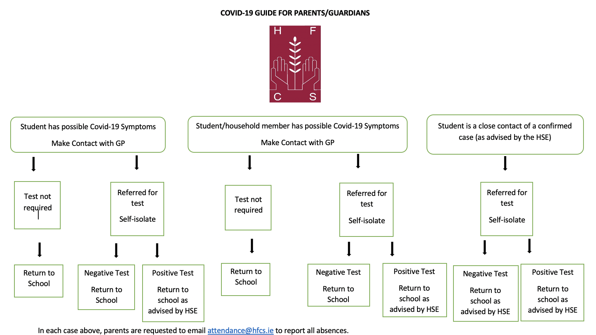

Slide 4
Transition Year Programme Aims
At the age of 15-16 young people are at a critical stage in growing up
It is very much a time of transition
One transition is from the dependence of childhood towards the relative independence of adulthood
Within school it is a time of transition between the Junior Certificate and the Leaving Certificate
Young people growing up have many needs, for example;
Personal
development
Social
development
Academic
development
Vocational
development

Slide 5
Purpose of Transition Year
Space provided to grow and mature
Students have many opportunities to practice team work skills, research skills , IT skills, project skills
Students become more self-directed learners through the development of general, technical and academic skills
Students gain in maturity in relation to work and careers by developing work-related skills and career planning
Opportunities to develop communication skills, self-confidence and a sense of responsibility

Slide 6
Multiple Aims of Transition Year
Bridge between childhood and adulthood
Bridge between junior cycle and LC programmes
Broad educational experience
Active and experiential learning
Education for maturity
Skills development
Experience of adult and working life
Promote personal, social, educational and vocational development
Autonomous, participative and responsible citizens
Education for
MATURITY
with emphasis on social
awareness and increased
social competence
Promotion of
general, technical and
academic SKILLS with
an emphasis on
interdisciplinary and
self-directed learning
Education through experience of ADULT and WORKING LIFE as a basis for personal development and maturity

Slide 7
Transition Year
Mindset
Need to embrace the change that comes with Transition Year:
  Transfer to Senior Cycle – additional privileges and responsibilities.
  New subjects.
  New friends.
  Different type of learning.
  New experiences.
  Gaisce/GAA Future Leaders/ Law Education
  Students are responsible for their own learning.
Need to maintain study/work pattern outside of school:
  Different approach to that utilised when studying the traditional curriculum – project-based, reflective.

Slide 8


Pastoral Care Team
Teachers, SNAs, Secretaries and Caretakers
TY Tutors Mr. M. Greene (TY1)
Mr. M. Fiorentini (TY2)
Ms. P. Ralph (TY3)
  Year Head Ms. L. O’Brien
  Chaplain Mr. N. McConnell

Slide 9
Pastoral Care Team
Guidance Counsellors Ms. K. O’Connell & Ms. C. Perris
AEN Coordinator Ms. Paula Dunne
Deputy Principals Mr. C. Morrin, Ms. I. Fallon & Ms. D. O’ Keeffe
Principal Ms. B. Kelly
Student Support Team

Slide 10
Student File at Home
Birth Certificate
PPSN
Passport
Medical Records (if applicable)
Junior Certificate results
Other Certificates e.g. First Aid, ECDL
Reports – school, work experience
Copies of application forms
Common Email (Gmail) accessible by student and parents

Slide 11
School Procedures
Correct students’ names needed for school records
SMS text alert re: attendance
If your child is absent: please contact attendance@hfcs.ie with your child’s name, year group and reason for absence.
If you have changed address or phone number, please contact info@hfcs.ie to update.
If your child has any medical conditions i.e. peanut allergies etc the school must be informed.
    Voluntary contribution – all help needed
    Student Insurance Scheme - €10 for 24 / 7 cover

Slide 12
Complaints / Concerns
Stages:
  Teacher / Tutor / Year Head
  Principal
  Representatives of the Board of Management
  Full Board of Management
  Teaching Council
Complaints Procedure on School’s website

Slide 13
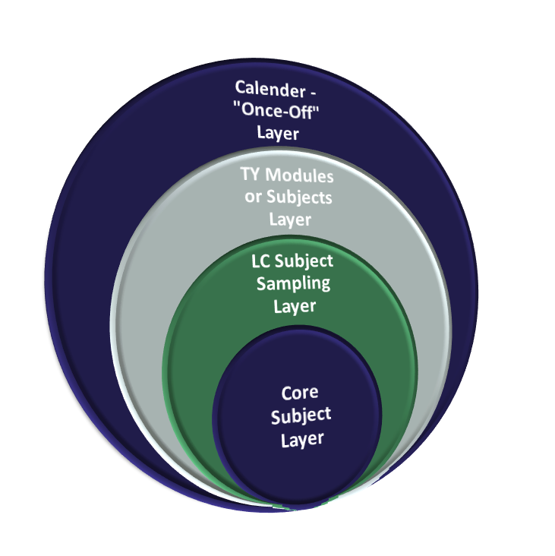
Four Layers of a Transition
Year Programme
“The Onion”
Notes:
Ongoing TY curriculum evaluation
Subject departments, teachers, students, external partners
Calendar layer
Evaluation of musical, work experience
TY specific/modular layer
Evaluation of Social Skills programme, Young Social Innovator, Enterprise
Subject sampling layer
Evaluation of French, German, Art & Heritage
Core subject layer
Evaluation of RE and Maths

Slide 14


Calendar “Once Off” Layer
Work Experience Placements.
Visiting Speakers.
Outdoor Pursuits.
Excursions.
Field Trips.
Community Care- Localise Youth Volunteering Programme.
Focus Ireland Sleepout
Pieta House- Darkness into Light
Gaeltacht

Slide 15

TY Modules/Subjects Layer
Science Communications
Law Education (online course)
Restorative Practice
SPHE
Guidance
Development Education
First Aid
Drama
Coding (ICT)
Future Leaders
Microsoft Office Specialist:
  →Word, PowerPoint, Excel.

Slide 16

LC Subject Sampling
Technology
Design and Communication Graphic
Art
World of Business
Music
History
Politics
Geography
Biology
Chemistry
Physics
Home Economics

Slide 17

Core subject Layer for TY
All students will take :
Mathematics
English
Gaeilge
Modern Language
Religion
PE

Slide 18

Transition Year Assessment
Credits for:
  All Modules = 10 credits each except for Art, Business, Modern Language and PE which are 15 credits per term
  Modules: class projects/assessment
  Christmas and Summer Reports (sent home to parents)
  Work experience diary & Guidance =40 credits
  Portfolio of Achievement (This is a reflective journal that students complete throughout the year) = 70 credits

Slide 19
TY Grade System
In total there are 500 credits to be awarded for the completion of HFCS’ TY Programme. TY Grade System is as follows;
Credits | Percentage | Grade Awarded
375-500 | 75-100% | Distinction
250-374 | 50-74% | Merit
150-249 | 30-49% | Pass
0-149 | <30% | Fail

Slide 20

Portfolio of Achievement (e-Portfolio via Teams)
Portfolio pieces are selected from class work (projects, presentations, artwork, essays etc.)
Tour/trip evaluations
Guest speaker evaluations
Event evaluations (e.g. Future Leaders, Coffee morning, Dev Ed STG Day)
Work Experience Diary (x2 for 2 different workplaces)
Photographic Diary
Unique Activities (e.g. Gaisce, Law Education)
Portfolio is corrected by Tutor and Year Head

Slide 21


Work Experience
Two Weeks 1st – 12th February 2021.
Students are responsible for finding their own placements.
Book placements early as there is a demand for places with the increasing number of TY students.
A variety of placements is recommended.
Check insurance policy with guidance teacher.

Slide 22

TY Fund
TY Fee is €300 and is due now. If there is an issue with payment please contact Ms. L. O’Brien (l.obrien@hfcs.ie)
Schools charges for TY typically range between €300-500.
  Costs of certification
  Costs of external experts/programme costs
  Fieldtrips
Costs of international trips are extra & around €500-600 * (Due to COVID19 it is highly unlikely that a trip of this nature will proceed)
Spontaneous & Ad-hoc trips/opportunities which companies/venues offer will incur extra small costs such as bus fees & admission fees throughout the year.
HFCS commits to being flexible and as forewarned & transparent as possible regarding costs. We will strive to achieve a balance between a richly rewarding programme & value for money.

Slide 23
Dates for Diary
Please keep an eye on the school website for important school dates.
This is an evolving situation due to COVID19.

